Slide 1

AWS SNS
BRINZEL RODRIGUES

Slide 2
SNS
“Amazon Simple Notification Service (Amazon SNS) is a fast, flexible, fully managed push notification service that lets you send individual messages or to fan-out messages to large numbers of recipients”
Amazon SNS makes it simple and cost effective to send push notifications to mobile device users, email recipients or even send messages to other distributed services.

Slide 3
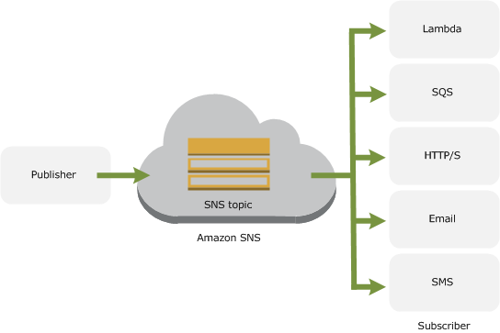
SNS

Slide 4
SNS
  Deliver messages instantly to applications or users and eliminate polling in your apps.
  Scale as you needs grow
  Send messages to individual devices or broadcast to multiple destinations at once.
  SDK available in iOS, Android, Java, Python, PHP, Node.js or .NET.
  Send notification to Apple, Android and other mobile devices and also destinations like SQS, Lambda and email address SMS and http endpoints.
  You can get delivery status information via cloud watch success and failure rates.

Slide 5
SNS
  Developers can get started with Amazon SNS by using just three APIs:
  CreateTopic,
  Subscribe, and
  Publish.
  Additional APIs are available, which provide more advanced functionality.

Slide 6
SNS
Supported Transport protocols for subscribers :
  “HTTP”, “HTTPS” (POST)
  ”Email”, “Email-JSON”
  “SQS” – Note that FIFO queues are not currently supported.
  “SMS Text Messages”

Slide 7

Question

